Slide 1

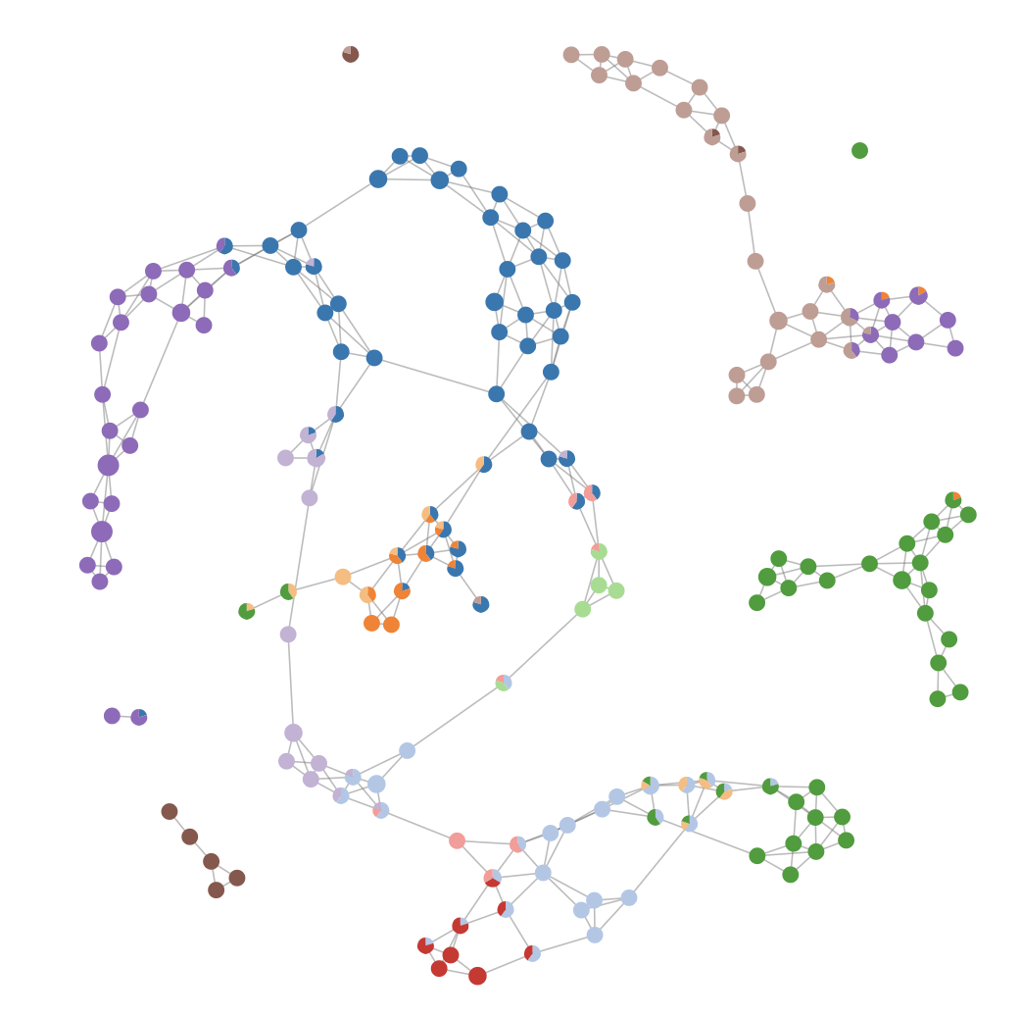
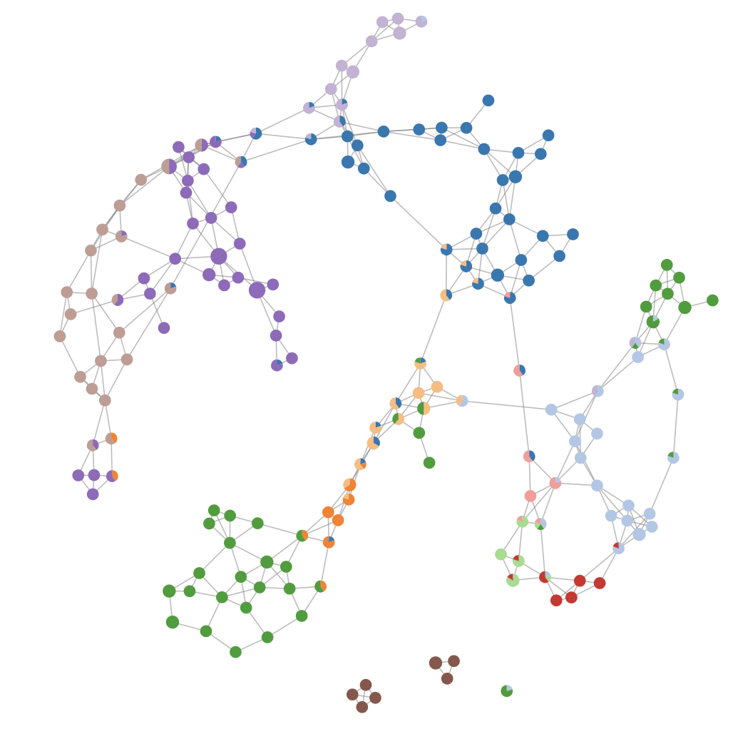
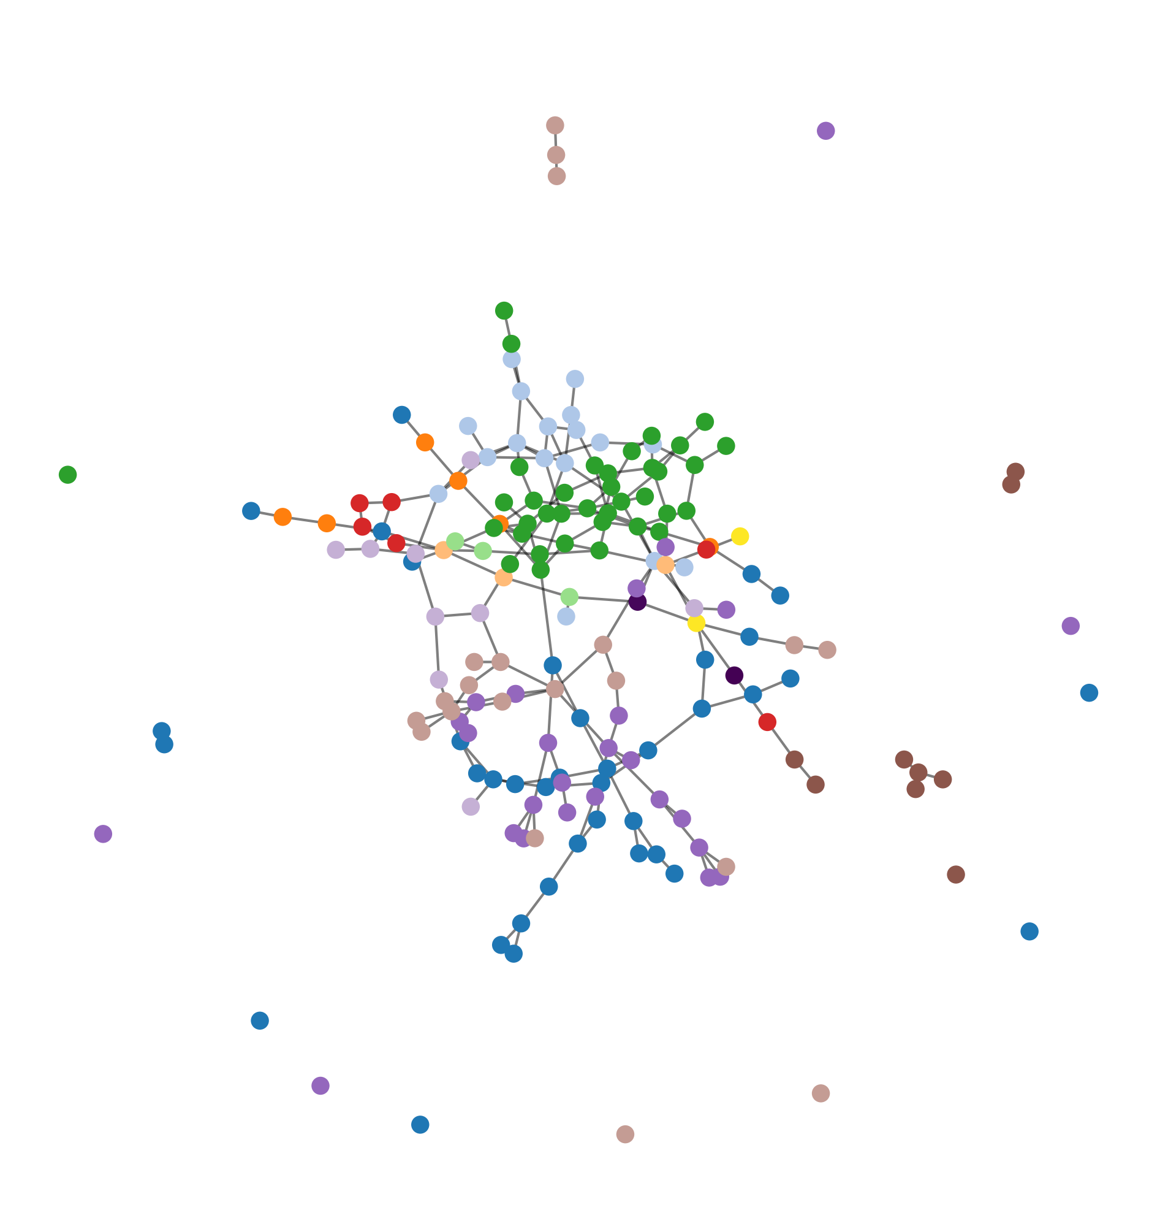
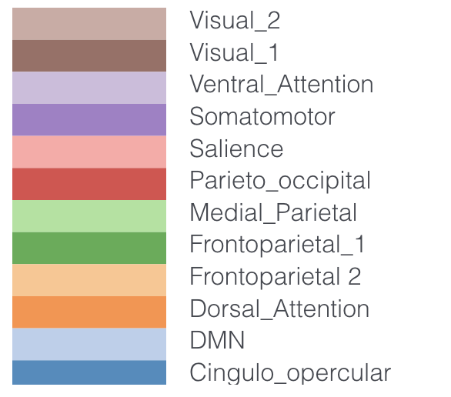
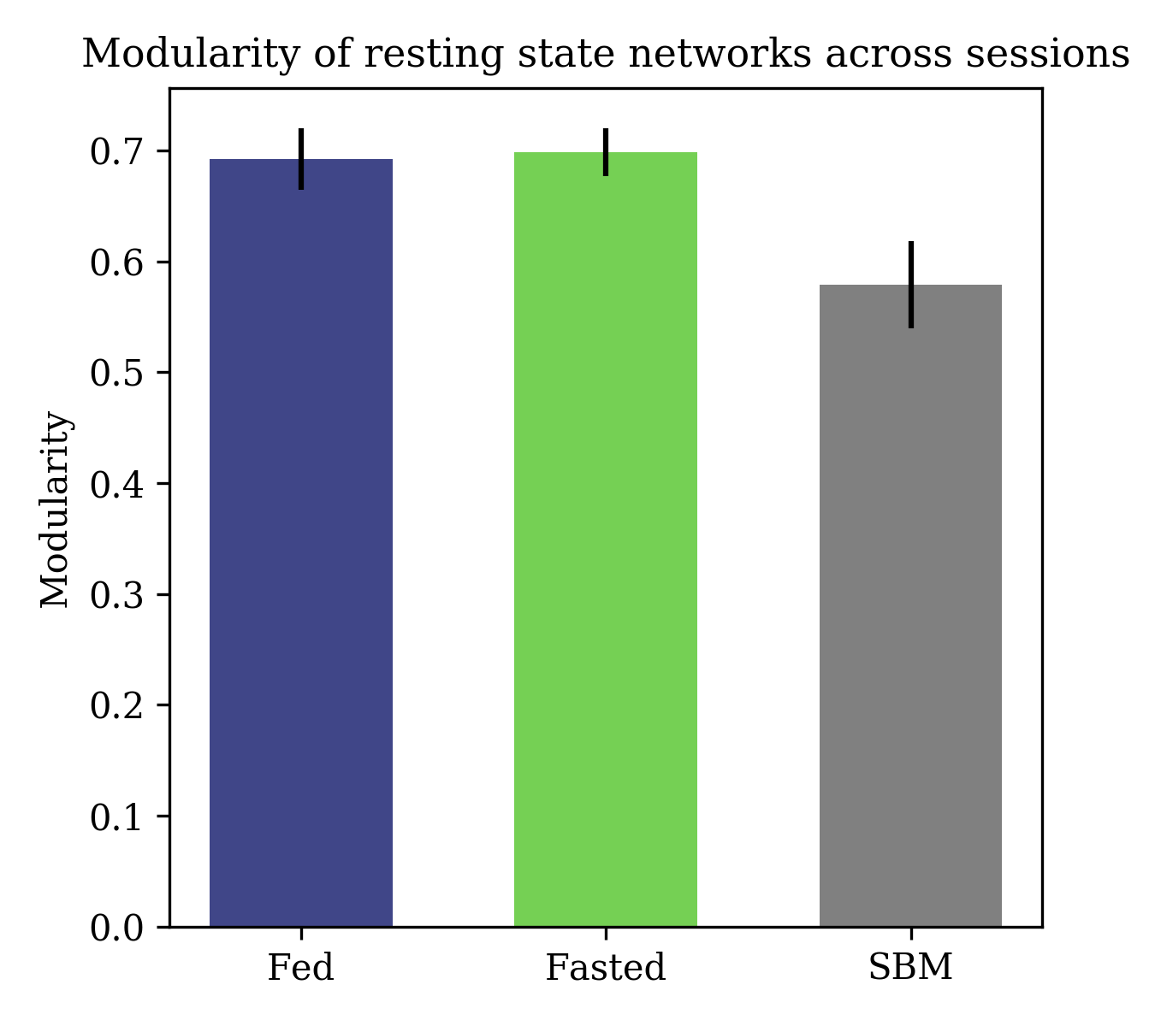
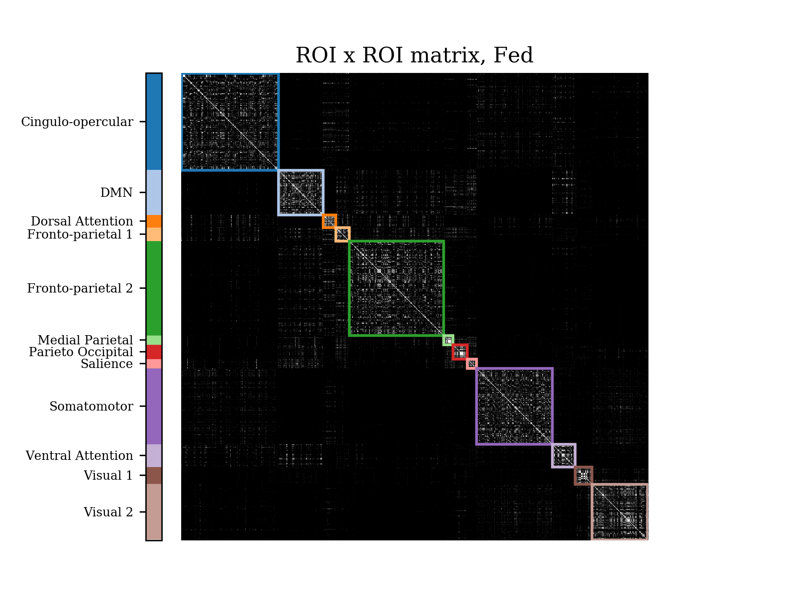

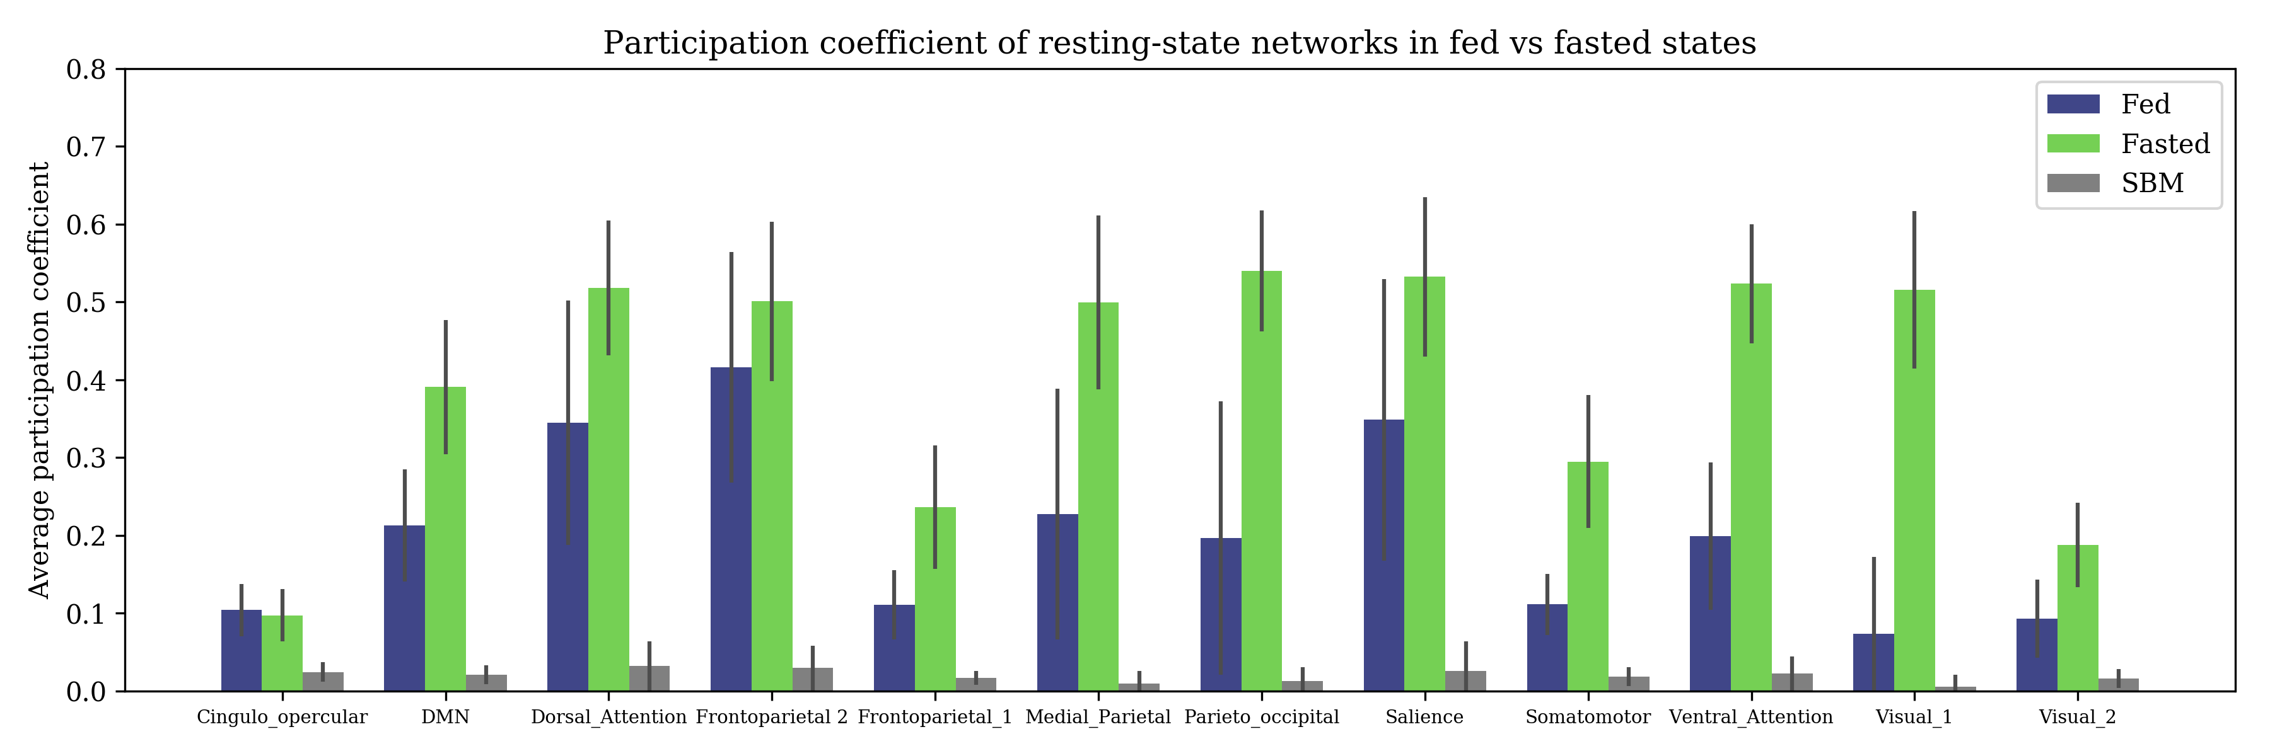
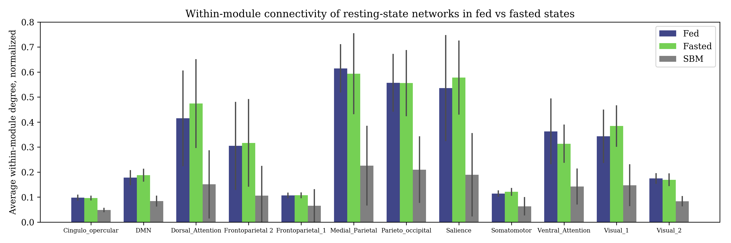
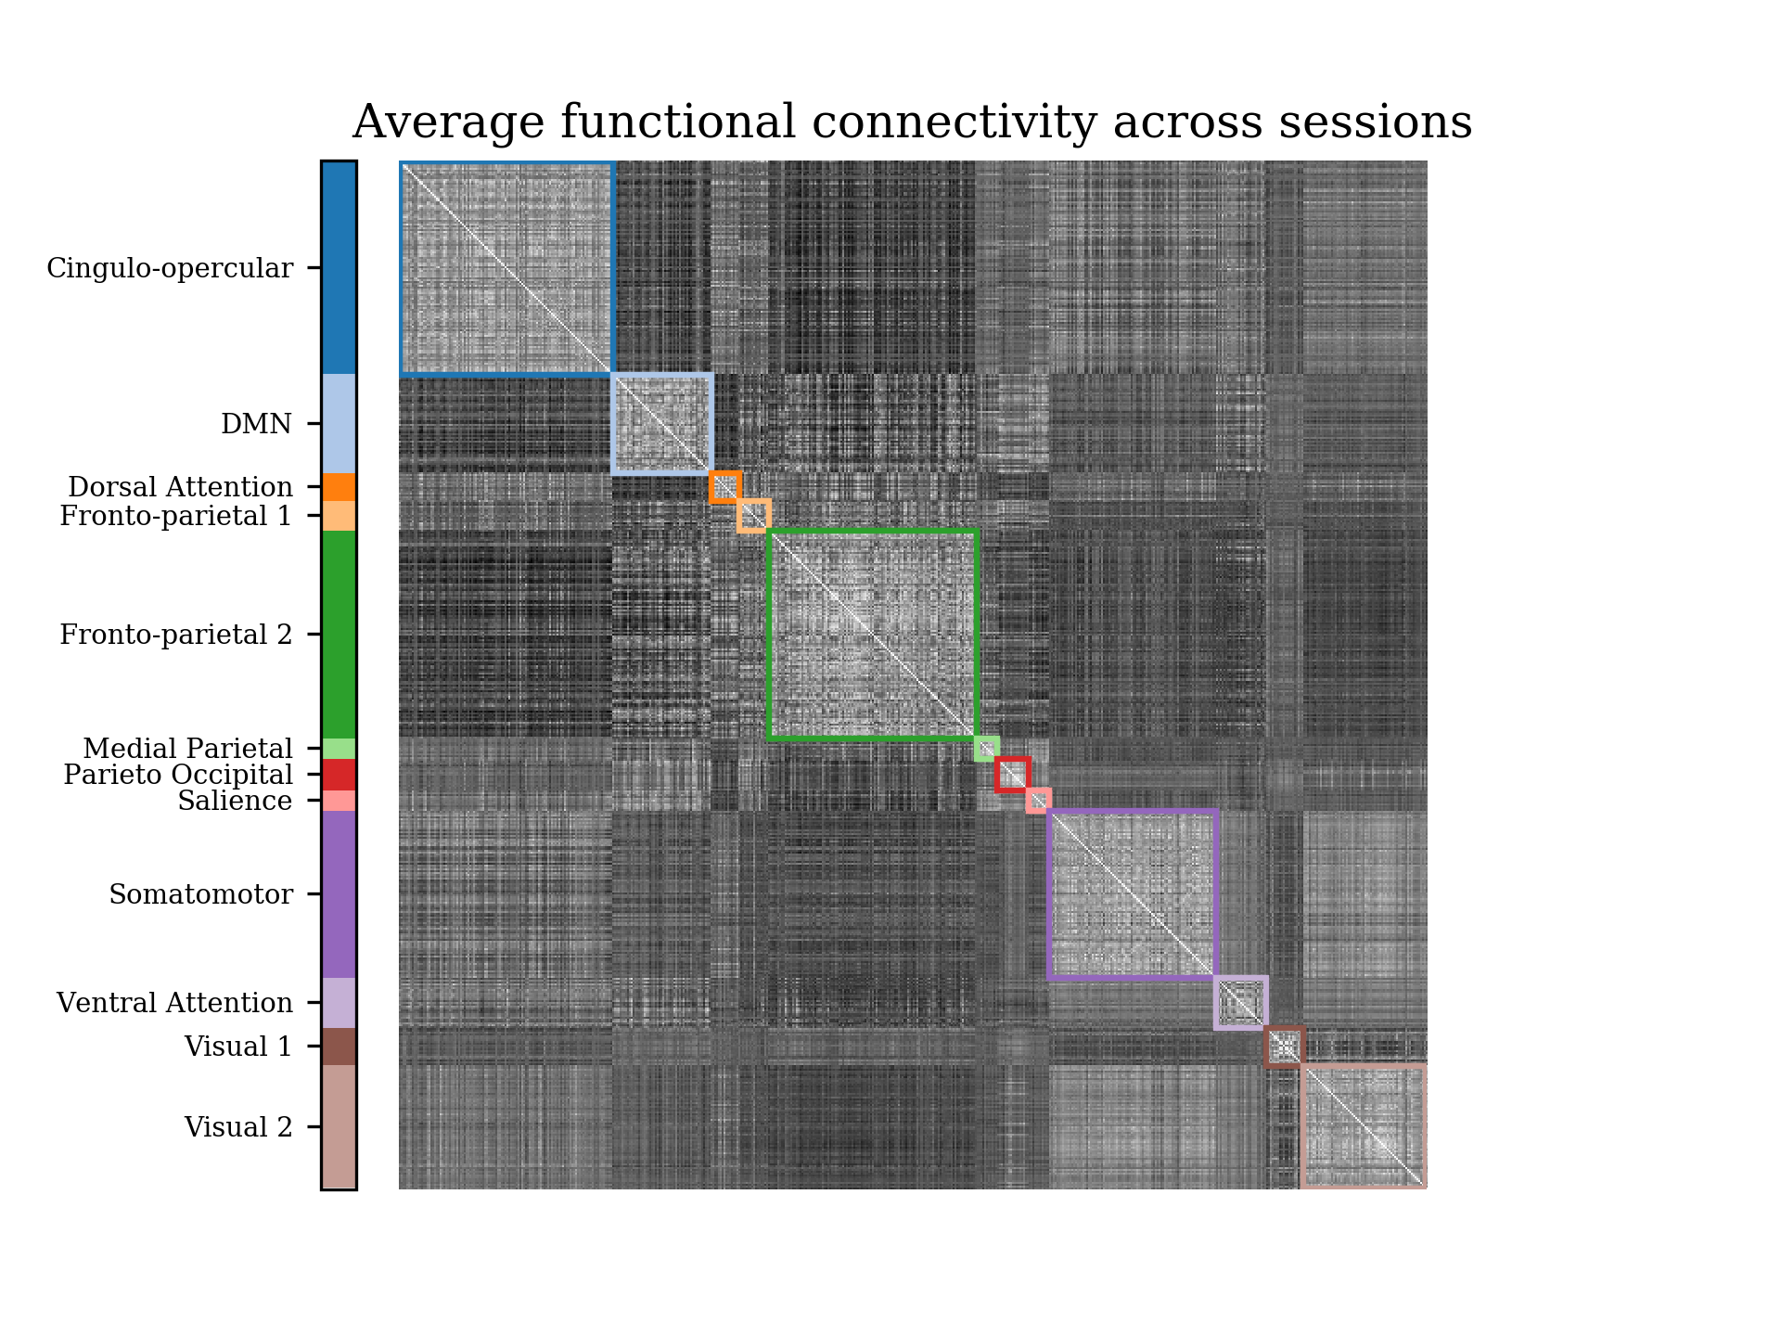

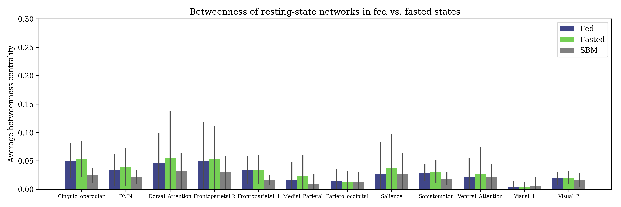
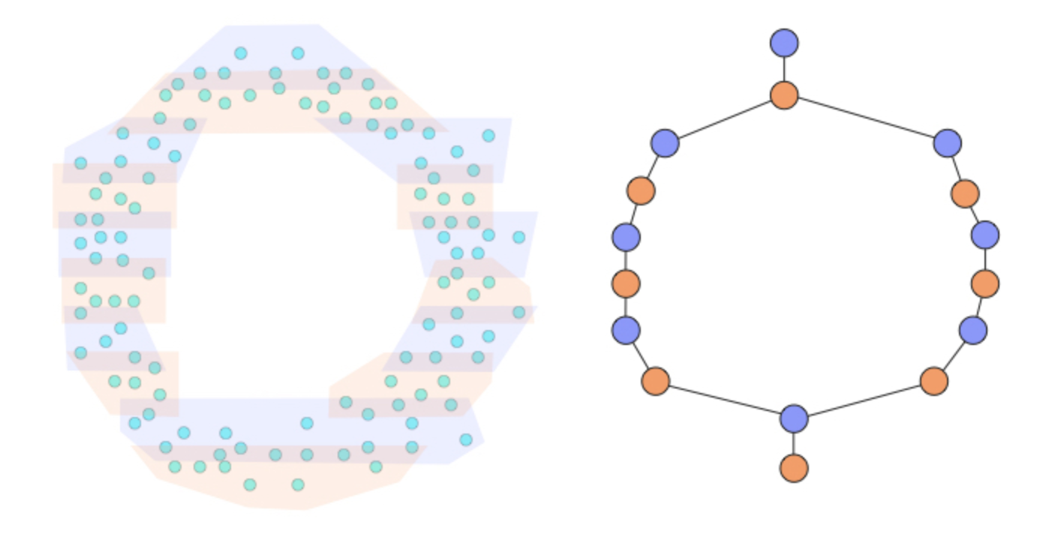
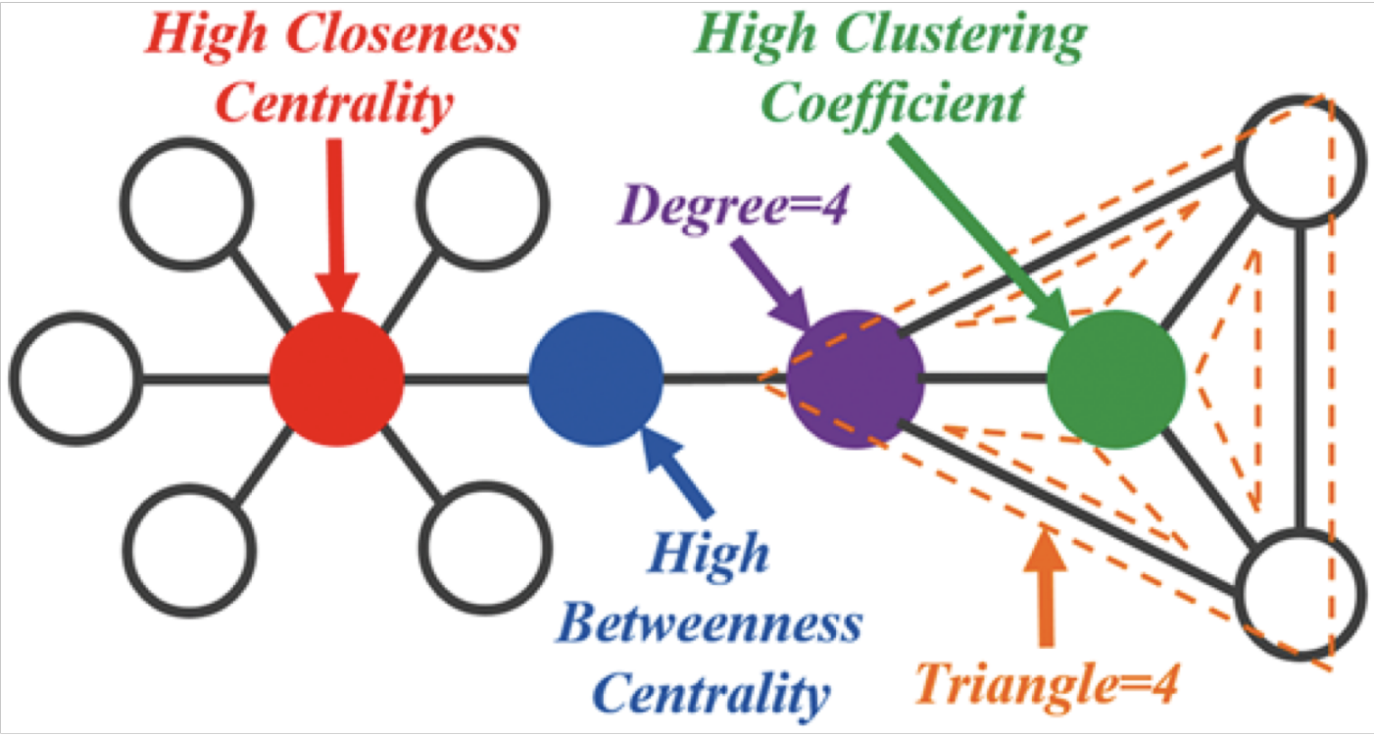
Exploring the functional networks of the resting brain with topological data analysis
Rafi Ayub^{1,2}
¹Department of Bioengineering
²Department of Psychiatry and Behavioral Sciences
Introduction
Results and Discussion
Background
The brain exhibits intrinsic activity with nuanced structure and rich dynamics even at rest when it is performing no explicit task [1]
Consistent patterns of correlations between regions, known as resting state networks (RSNs) show diverse interactions at rest
Psychiatric disorders have been linked to the dysregulation of these networks; changes in mood or arousal can also affect network dynamics [2][3]
Problem
Current methods of characterizing resting state functional connectivity are linear and may fail to reveal important non-linear structure and relationships between brain regions and networks
How does physiological state, such as fasting, change brain dynamics?
Solution
Non-linear methods from topological data analysis (TDA) may provide unique insight into the brain’s functional architecture
A
B
C
Figure 1: (A) Mapper graphs created by running once on all scans concatenated for fasted state, fed state, and the null SBM, from left to right. (B) Legend assigning each color to an RSN. (C) Comparison of graph modularity by using RSN labels as community assignments.
A
A
B
Networks tend to have their own roles and connect to other networks preferentially. Ex: DMN tends to connect with many RSNs, FP1 tends to hang in periphery
Real brain graphs exhibits higher modularity, participation coefficient, within-module connectivity than SBM
RSNs in fasted state show higher participation across the board
RSNs in real brain graphs show more internal structure than SBM, demonstrating that structure is not solely due to self-preference
Methods
Dataset
MyConnectome: complete metabolic profile + 84 fMRI scans of a single subject over a year – 31 in fed state, 40 in fasted state
Mapper
Tool from TDA/manifold learning that can capture the structure of the data
Project data into lower-dimensional embedding using tSNE
Bin points according to resolution parameter
Bins on lower-dim points guide partial clustering on original high-dim points – we use hierarchical clustering, HBDSCAN
Result is a graph that represents the “shape” of original data
Network analysis
Betweenness centrality
Within-module degree
Participation coefficient
Modularity/community structure
Stochastic Block Model (SBM)
B
C
D
C
Figure 2: ROI x ROI adjacency matrix (ROI = region-of-interest), where each row or column is a subject-specific parcellated brain region. A matrix element is 1 if the ROIs corresponding to the row and column are found in the same node or are in two connected nodes. The matrix was averaged across all scans – 31 for fed (A), 40 for fasted (B), all 84 for SBM (D). These are compared to the average correlation matrix of the ROIs’ timeseries across all scans, showing that the Mapper graph can embody these relationships.
Figure 3: Comparison of participation coefficient (A), within-module connectivity (B), and betweenness centrality (C) among the three types of graphs. Values were averaged across all nodes within an RSN within a scan, and then averaged across all scans.
Stochastic block model. Adapted from [4]
Conclusions
References
Illustration of the Mapper algorithm,. Adapted from [6].
Brain networks have high participation coefficient yet maintain high within-module degree. The brain is modular and optimizes integration and segregation of function
In the fasted state, brain networks communicate with one another more often than in the fed state
Deco, G., Jirsa, V. K., & McIntosh, A. R. (2013). Resting brains never rest: Computational insights into potential cognitive architectures. Trends in Neurosciences, 36(5), 268–274. https://doi.org/10.1016/j.tins.2013.03.001
Xu, T., Cullen, K. R., Mueller, B., Schreiner, M. W., Lim, K. O., Schulz, S. C., & Parhi, K. K. (2016). Network analysis of functional brain connectivity in borderline personality disorder using resting-state fMRI. NeuroImage: Clinical, 11, 302–315. https://doi.org/10.1016/j.nicl.2016.02.006
Poldrack, R. A., Laumann, T. O., Koyejo, O., Gregory, B., Hover, A., Chen, M. Y., … Mumford, J. A. (2015). Long-term neural and physiological phenotyping of a single human. Nature Communications, 6. https://doi.org/10.1038/ncomms9885
Abbe, E., Bandeira, A.S., & Hall, G. (2016). Exact Recovery in the Stochastic Block Model. IEEE Transactions on Information Theory, 62, 471-487.
Jure Leskovec, Stanford CS224W: Social and Information Network Analysis, http://cs224w.stanford.edu
Saul, Nathaniel. What is Mapper? https://sauln.github.io/blog/mapper-intro/
Depiction of betweenness centrality. Adapted from [5]

